Slide 1
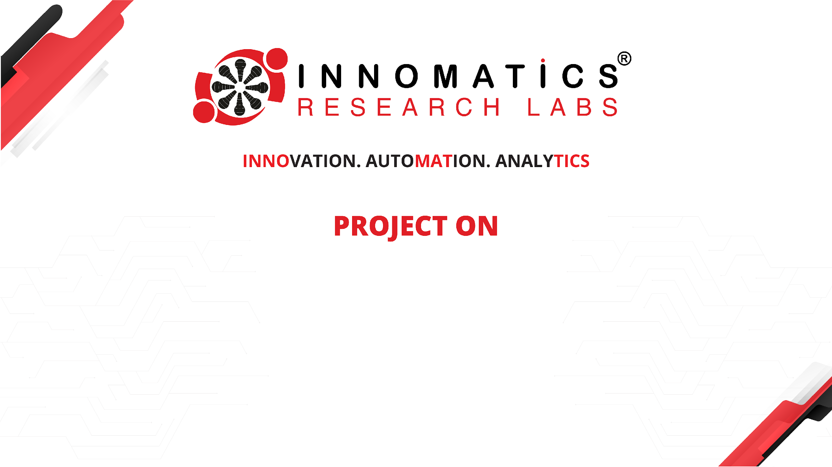
Web Scrapping and Visualization of Ambition Box
Compiled by: Shruti Jakkulwar

Slide 2
Problem Statement
Job seekers and career counselors in India frequently struggle to make informed decisions about potential employers due to a lack of comprehensive, quantitative insights into company reputation, compensation benchmarks, interview difficulty, and active hiring trends across diverse industries and locations. This often leads to suboptimal career choices, missed opportunities, and dissatisfaction with employment prospects.
Key Insights :
Positive Employer Branding Drives Active Hiring.
IT Services & Consulting Dominates Key Indian Job Markets.
Competitive Salaries Attract Strong Talent Engagement.
Companies Are Expanding Hiring Beyond Major Urban Centers.
Analyzing Interview-to-Job Ratios Reveals Recruitment Efficiency.

Slide 3
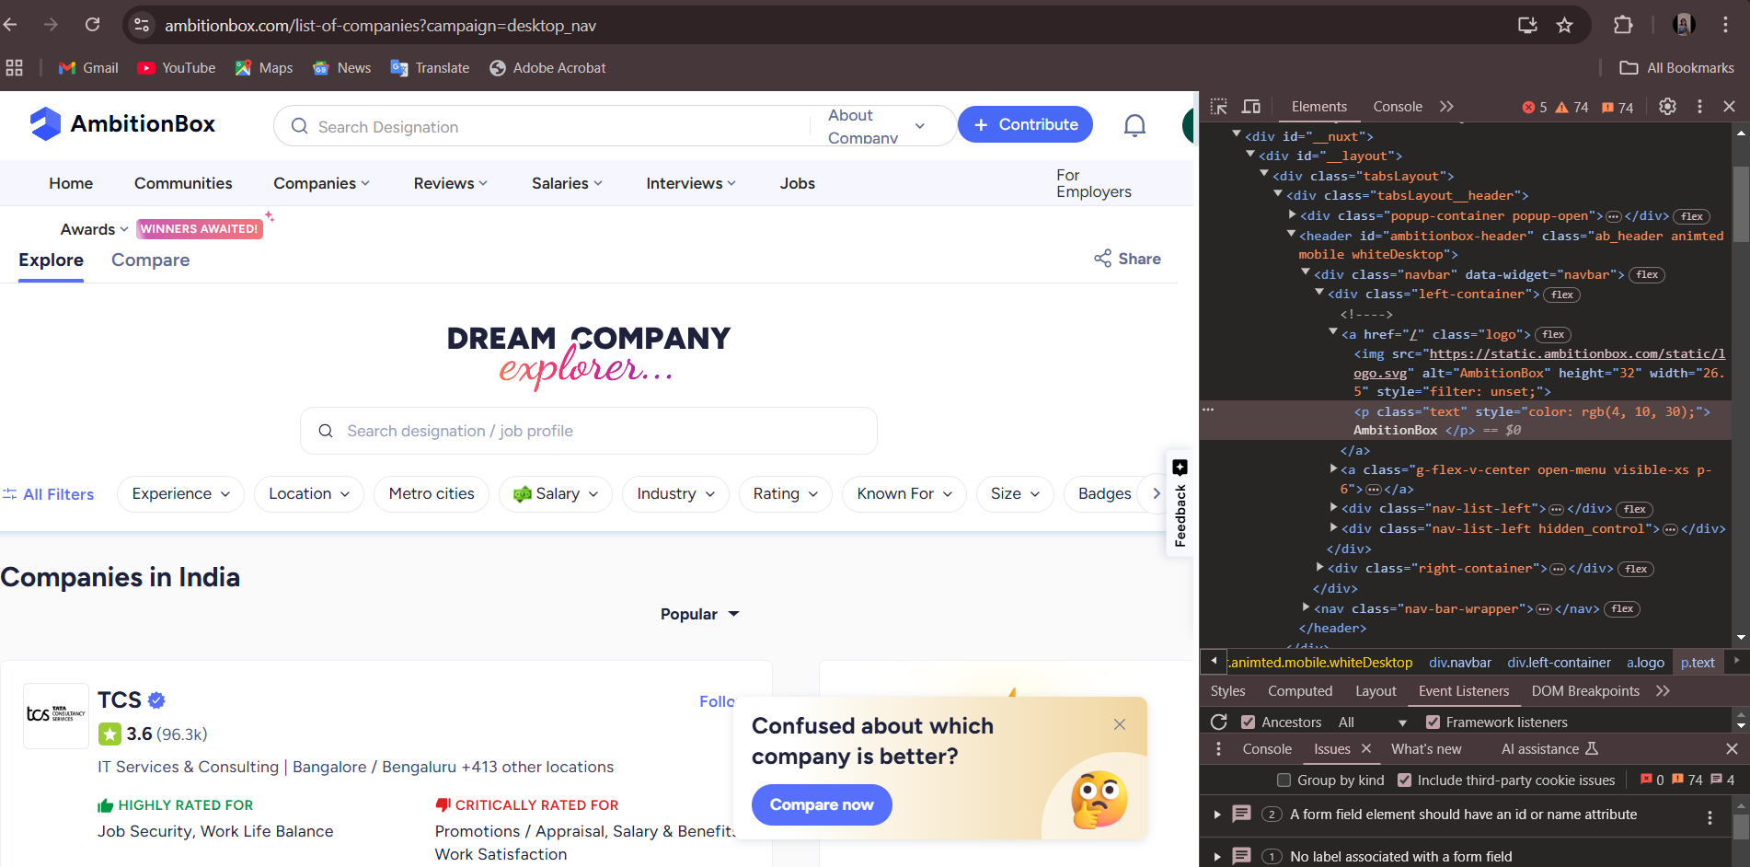
Web Scrapping
Website URL :
https://www.ambitionbox.com/
Webscrapping Tools:
Requests
Beautifulsoup

Slide 4
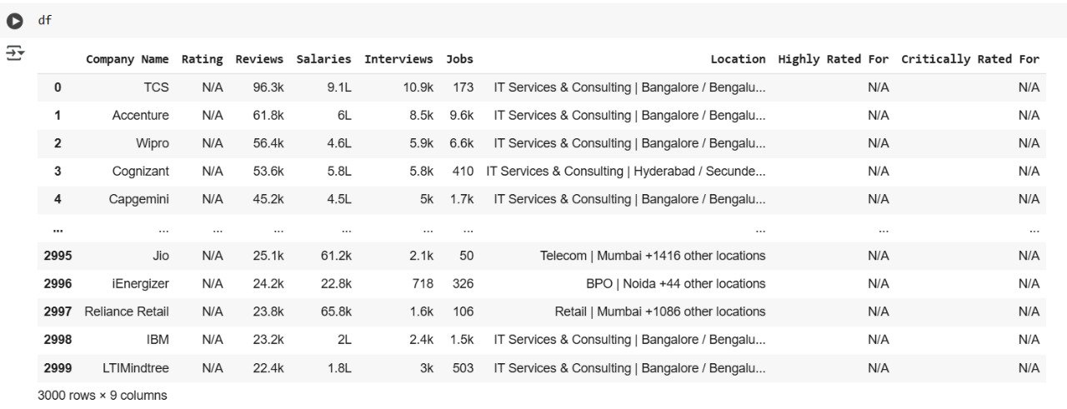
Data Extraction
Extracting Sample & Features From Raw Data
Creating Dataframe
Extracted Data Before Cleaning

Slide 5
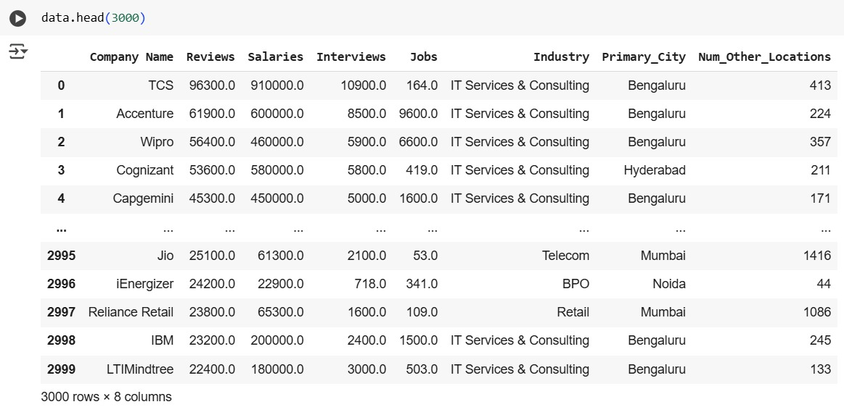
Data Cleaning
Check Duplicate Value
Drop Unwanted Columns
Text Cleaning
Modifying Data Types
Extracted Data After Cleaning

Slide 6

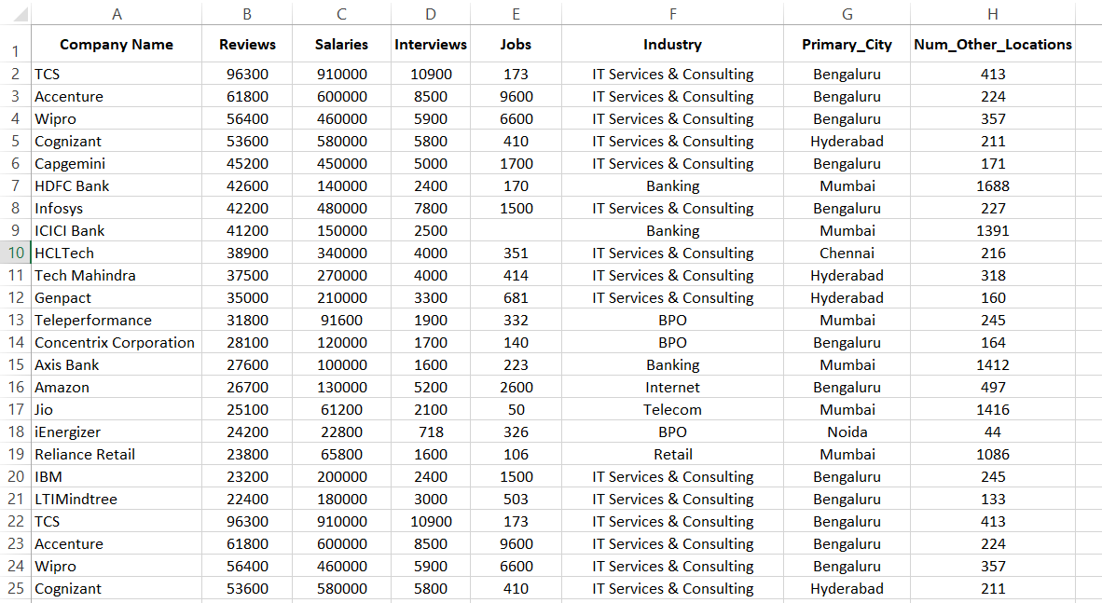
Data Acquisition
Ambition Box Insights Saved to CSV

Slide 7
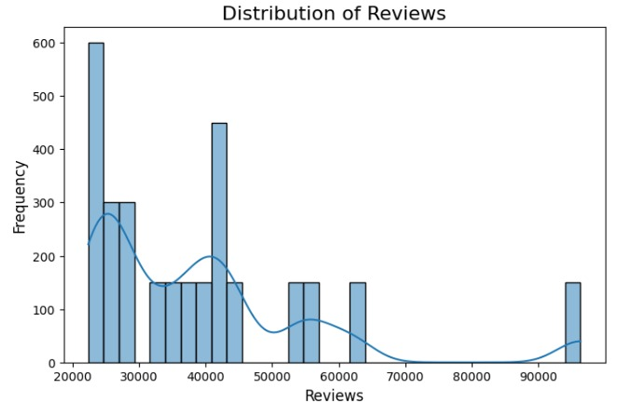
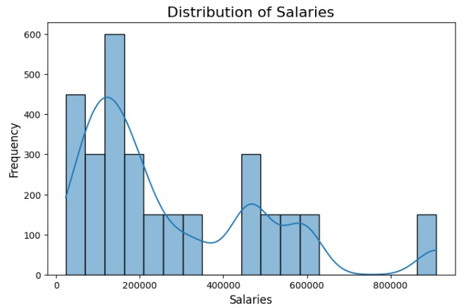
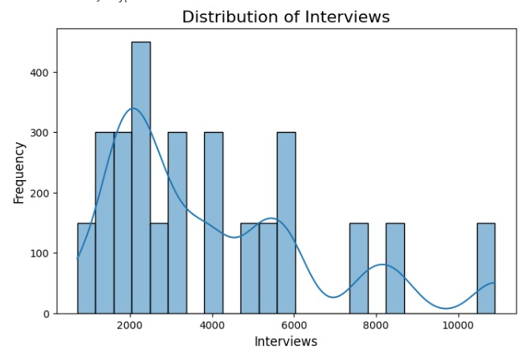
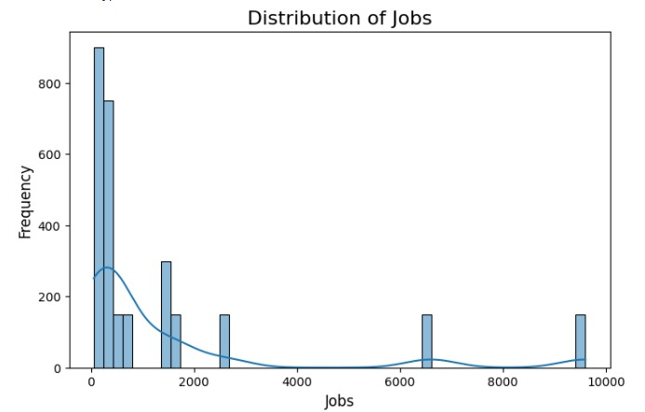
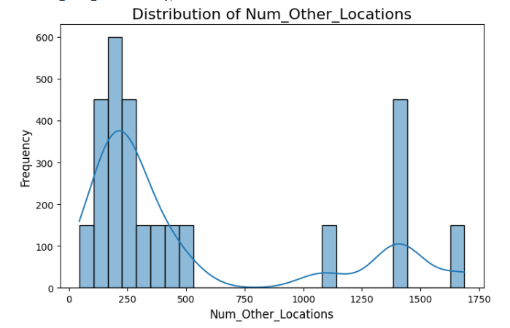
Data Visualization
Univariate Analysis On Numerical Columns

Slide 8
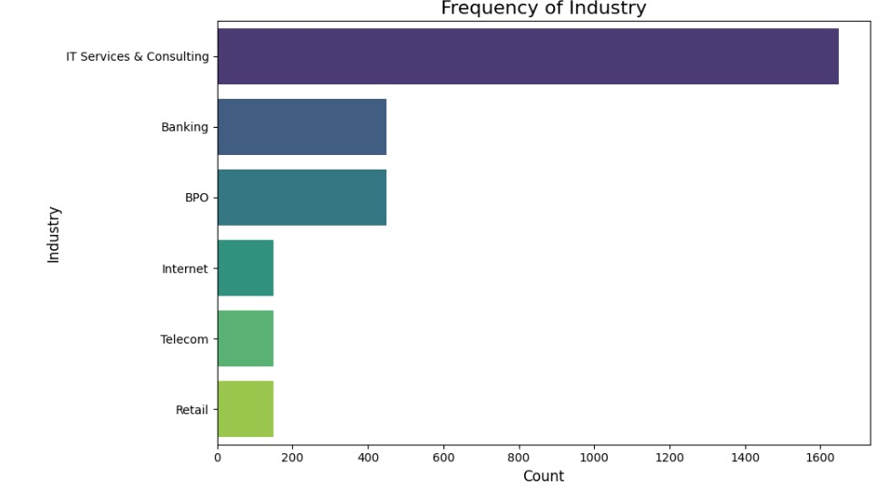
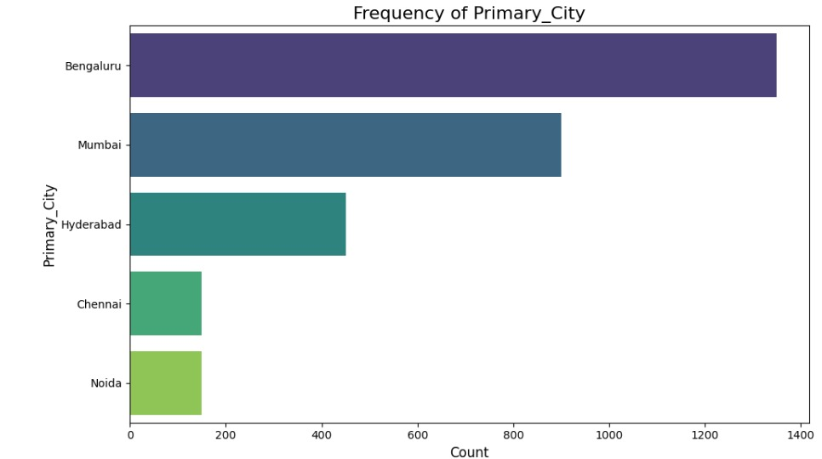
Data Visualization
Univariate Analysis On Categorical Columns

Slide 9
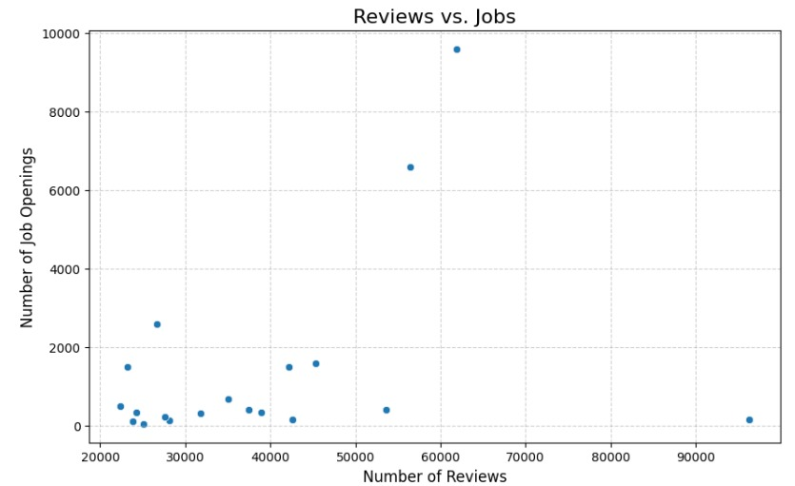
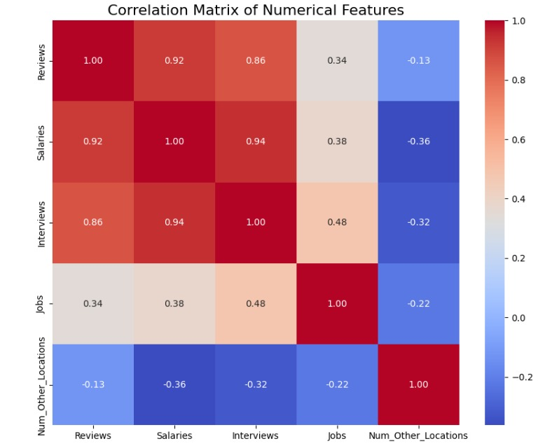
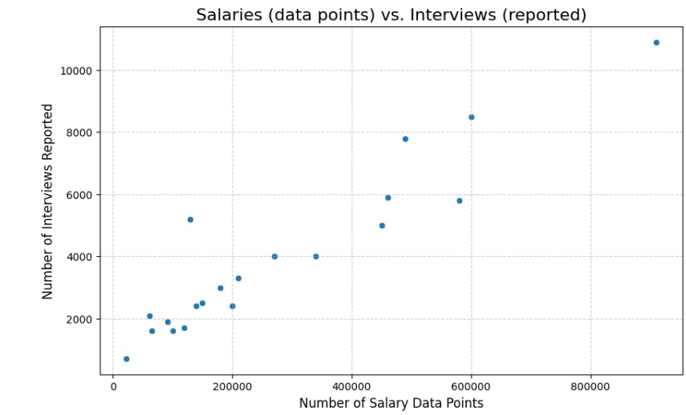
Data Visualization
Bivariate Analysis On Numerical Vs Numerical Columns

Slide 10
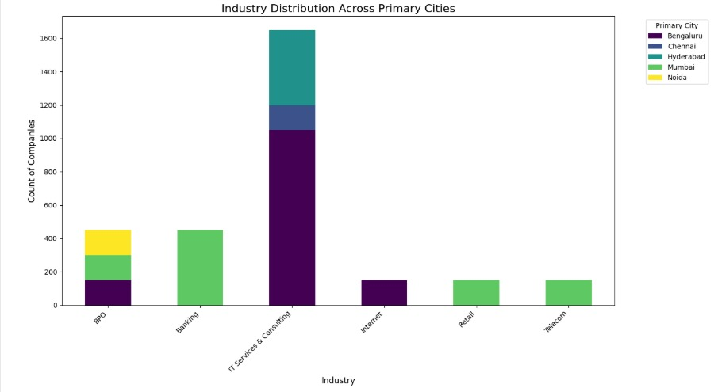
Data Visualization
Bivariate Analysis On Numerical Vs Categorical Columns

Slide 11
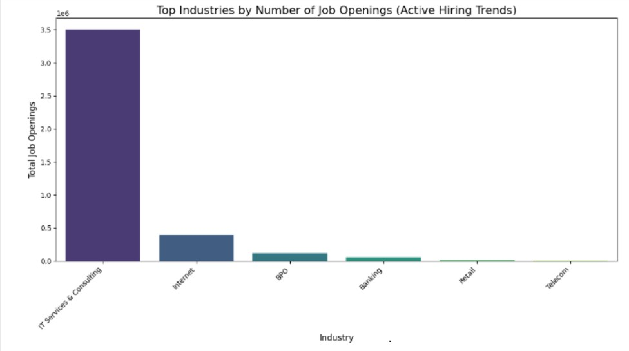
Data Visualization
Insight 1: Top Industries with Active Hiring (Addressing "Active Hiring Trends“)
Observation : The IT Services & Consulting industry dominates job openings, surpassing all other industries by a significant margin

Slide 12
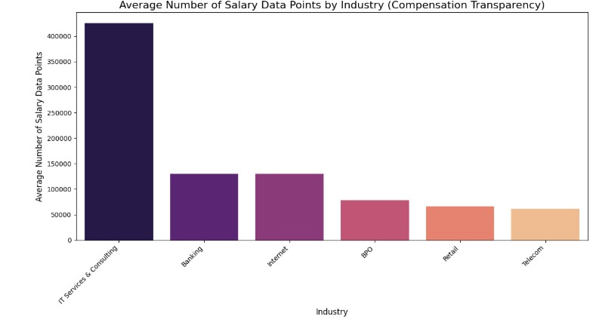
Data Visualization
Insight 2: Compensation Benchmarks by Industry (Addressing "Compensation Benchmarks")
Observation : The IT Services & Consulting industry leads in compensation transparency, with significantly more salary data points than other sectors.

Slide 13
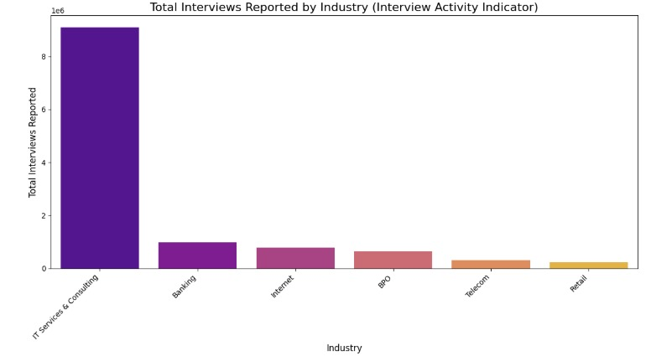
Data Visualization
Insight 3: Interview Activity by Industry (Addressing "Interview Difficulty")
Observation : The IT Services & Consulting industry far exceeds all others in compensation transparency, with an unparalleled number of salary data points.

Slide 14
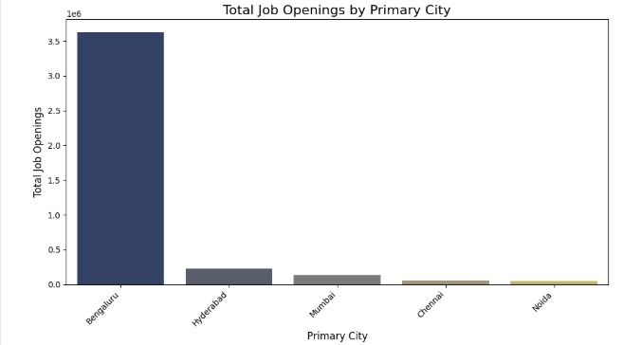
Data Visualization
Insight 4 : Geographic Distribution of Job Opportunities (Addressing "Location" in problem statement)
Observation : The IT Services & Consulting industry stands out with a significantly higher number of salary data points, signaling the highest compensation transparency among all sectors.

Slide 15
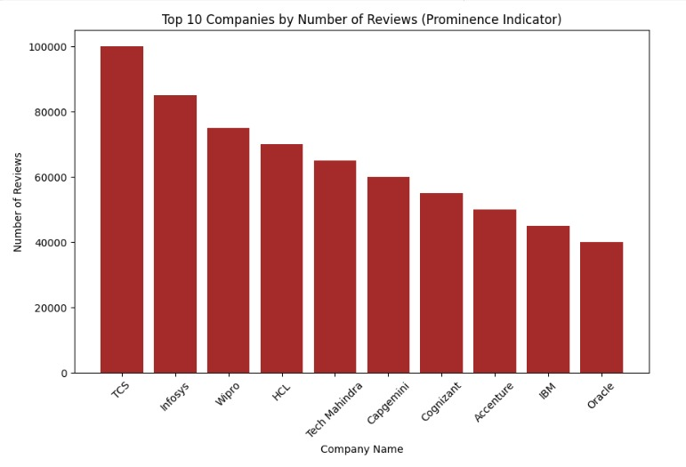
Data Visualization
Insight 5: Companies with Highest Review Counts (Proxy for Prominence/Reputation)
Observation : TCS dominates the review landscape, accumulating nearly 100,000 reviews - far surpassing any visible competitor.

Slide 16
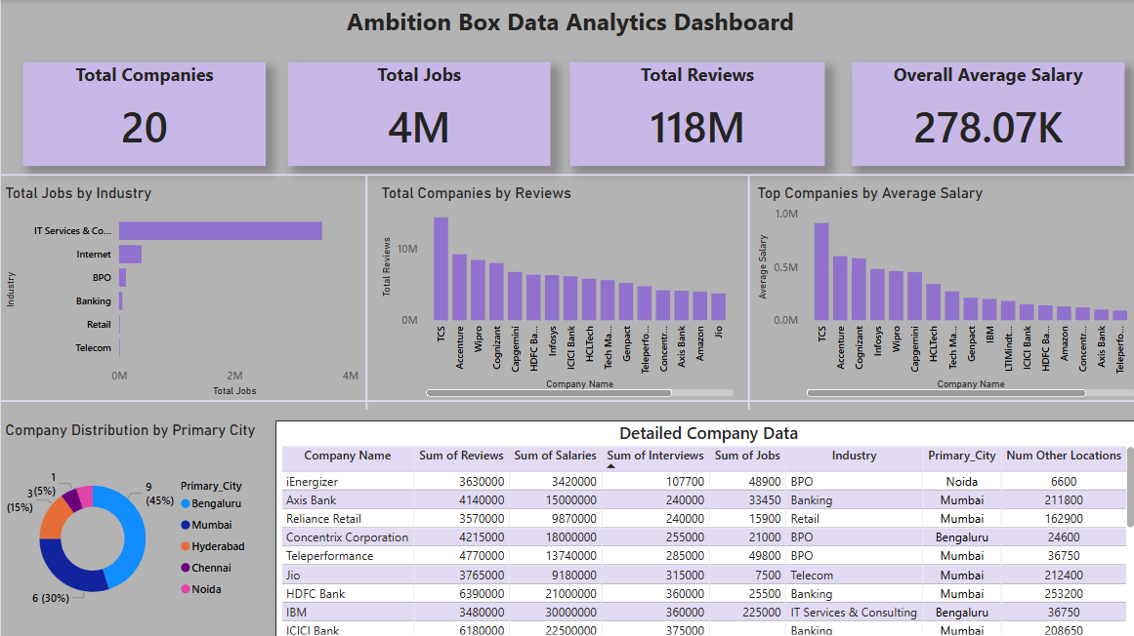
Power BI Dashboard

Slide 17
Conclusion
Successful Data Acquisition: The project successfully established a framework for scraping key company, review, job, salary, and location data from Ambition Box, demonstrating effective data extraction capabilities.
Robust Data Cleaning Pipeline: A comprehensive cleaning and parsing pipeline was developed to transform raw scraped text into structured and usable data, addressing inconsistencies in location and salary formats.
Actionable Insights Generated: The cleaned dataset enabled the extraction of impactful insights regarding market trends, employer branding, hiring landscapes, and compensation benchmarks, crucial for strategic decision-making.
Foundation for Further Analysis: This project lays a strong foundation for deeper analytical explorations, including sentiment analysis of reviews, predictive modeling of hiring trends, and competitive intelligence gathering.
Scalability and Efficiency: The use of Python with Pandas ensures that the scraping and cleaning processes are scalable and efficient, capable of handling large volumes of data for continuous monitoring or larger datasets.

Slide 18

THANK YOU

